Slide 1
Mobile and Wireless Technology
CT090-3-2-MWT and Version VC1
Introduction and Overview

Slide 2
Lecturer information
Lecturer Name: Dr. K.C. Arun
Email: kchandran.arun@staffemail.apu.edu.my
Telephone Extension:

Slide 3
Pre-requisites for this module
None

Slide 4
Aims of this module
This module will cover the various area of mobile and wireless technology, WLAN System Architecture and Design, WLAN Security, and Broadband Wireless Access: Mobile WiMAx and WiFi

Slide 5
Course Learning outcomes, CLOs
At the end of this course, YOU should be able to:
Apply the technical concept of Wireless LAN technologies to any given scenario
Study the future developments of Mobile and Wireless Network
Demonstrate the ability to design WLAN infrastructure and troubleshoot wireless network problems

Slide 6
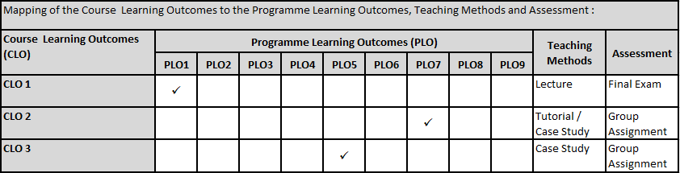
Mapping of CLOs with MOEs Domain
PLO1 – Knowledge
PLO5 – Social Skills, Teamwork and Responsibilities
PLO7 – Information Management and Lifelong Learning Skills

Slide 7
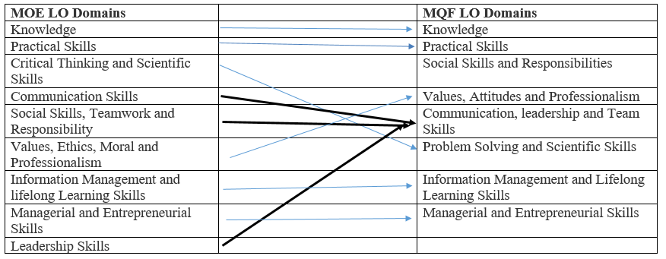
MQF and MOE Domains

Slide 8
Teaching Strategies
Lecture
Tutorial
Case Study (Individual and Group)

Slide 9
Assessment Methods
Final Exam (40%) : CLO1
Group Assignment (60%)
Research : CLO2
WLAN Infrastructure Design : CLO3
**refer to SAIS for details

Slide 10
Student Learning Time (SLT)
Course Credit Value: 3
Total Learning Hours:
Lecture: 20 hours per semester
Tutorial / Case Study : 22 hours per semester
Independent Learning Time: 66 hours

Slide 11
Methods of Delivery
Hence,
We are now moving from the traditional topic based teaching to outcome-based education

Slide 12
Outcomes Based Education (OBE)
OBE is education based on producing particular educational outcomes that:
Focus on what students can actually do after they are taught
Expect all learners / students to successfully achieve particular (sometimes minimum) level of knowledge and abilities.

Slide 13
So…What is OBE?
It’s
NOT
What we want to teach,
It’s
What You should learn

Slide 14
Course Content Outline
CLO1 : Final Exam (40%)
Lecture
Introduction to WLAN & Wireless LAN Infrastructure Devices
Radio Frequency (RF) Fundamentals for Wireless LAN Technology
WLAN Terminology and Technology
WLAN Security

Slide 15
Course Content Outline
CLO2 & CLO3 : Group Assignment (60%)
Tutorial / Case Study
Case Study: WiMAX and LTE
Other current technologies
The Future: Li-Fi
IoT and Wireless Sensor Networks
Case Study: Troubleshooting and Maintaining Wireless Networks
Case Study: WLAN Site Survey

Slide 16
What is expected of you
What is expected of you
You should abide to all the rules & regulation of APU
Proper attire
No speaking of dialects
Attendance is compulsory and valid medical certificates or letters from parents /guardians must support any absence from class.
Three lateness will be equal to one absence
All pagers and handphones should be turned off during lectures.

Slide 17
What support is available for you
Consultation hours
Resources
Reference material
Essential Reading
Bartz,R. J.(2017) CWTS, CWS, and CWT Complete Study Guide: Exams PW0-071, CWS-2017, CWT-2017 .3rd Edition.New York:Wiley.ISBN-13: 978-1119385035.
Al Agha,K. Pujolle,G. and Ali Yahiya,T.(2016)Mobile and Wireless Networks (Networks & Telecommunications Series: Advanced Network Set). New York:Wiley.ISBN-13: 978-1848217140.
Internet resources
Software : EKHau Heat Mapper (Open Source)

Slide 18
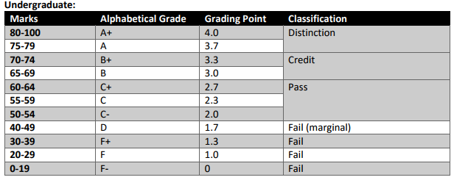
Achievement requirements

Slide 19
Question and answer session
Q & A

Slide 20
What we will cover next
Introduction to WLAN & Wireless LAN Infrastructure Devices

